Slide 1
By:
Eden Daniel
Meklit Zenabu
Jorden Denny

Slide 2
Songs On Our Album
Fela Kuti- Sorrow, Tears, and Blood
Bob Dylan- Oxford Town
Ani Difranco- Hello, Birmingham
The One of the Right is the Left- Johnny Cash
The Specials- Gangsters
Yaz Gazeteci Yaz- Selda Bagcan
Leadbelly- On A Monday
Alice’s Restaurant Massacre- Arlo Guthrie
Frank Zappa- Central Scrutinizer
Frank Zappa- Heavenly Bank Account
Dead Kennedys- Moral Majority
Don Henley- All She Wants to Do Is Dance
Fight the Power- Public Enemy

Slide 3
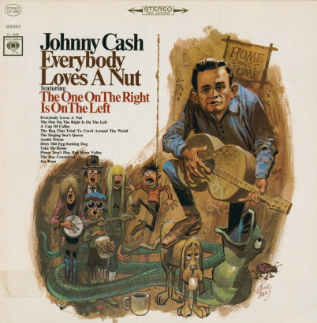
“The One on the Right is the Left”
Johnny Cash
“The One on the Right is the Left”
Applies to the First and Ninth Amendments
Political views and music should not intertwine
Recorded by Cash in 1965
Written by Jack Clement

Slide 4
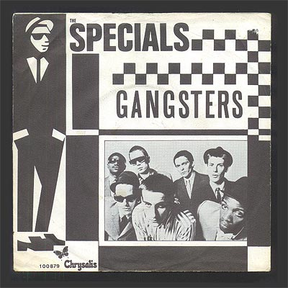
The Specials- “Gangsters”
Applies to the Fourth and Eighth Amendments
Song is actually based on one of the band’s tours to France
Blamed for causing damages to a hotel that another English band before them had actually caused
A guitar is taken as “compensation” for the damages
Recording phone calls - violation of privacy.

Slide 5
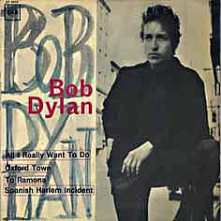
“Oxford Town”
Bob Dylan
Written and performed by Bob Dylan
Broadside magazine invitation
Social commentary about James Meredith going to the university of Mississippi
Applies to the 14th amendment
Equal protection of the law
He went down to Oxford town
Guns and clubs followed him down
All because his face was brown
Better get away from Oxford town
Oxford town around the bend
He come in to the door, he couldn't get in
All because of the color of his skin
What do you think about that, my friend?

Slide 6
Yaz Gazeteci Yaz (Write Journalists Write)
A Turkish protest song by Selda Bağcan
Applies to first amendment
Freedom of the press - the right of journalists to freely report in her hometown
“For heavens sake journalist come to our village and write about our situation
Don't write about painted fingers in the city
Write about the calloused hands in our village
Write write journalist write
Write write sir write”
“Aman gazeteci gel bizim köye bizim halları da yaz
Şehirde ojeli parmakları yazma
Bir de bizim köyde nasırlanmış elleri de
Yaz yaz gazeteci yaz,
yaz yaz efendi yaz”

Slide 7
Alice’s Restaurant Massacre- Arlo Guthrie
Song based on true story
Convicted of littering
could not enlist for Vietnam War
8th amendment
punishment does not fit crime, excessive fines
5th amendment
self incrimination
“We found your name on an envelope at the bottom of a half a ton of garbage, and just wanted to know if you had any information about it."
"Yes, sir, Officer Obie, I cannot tell a lie, I put that envelope under that garbage."
due process right to a fair trial (impartial jury)
6th amendment
lack of counsel to represent him in his case before the judge
7th amendment- “In Suits at common law, where the value in controversy shall exceed twenty dollars, the right of trial by jury shall be preserved”
50 dollar fine, no jury

Slide 8
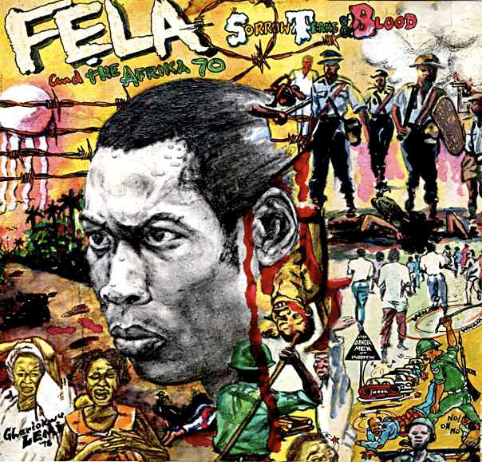
Sorrow, Tears and Blood- Fela Kuti
Nigerian Afrobeat musician
Criticizes government
Faced attack by the government
Nigerian military raid (1977)
Kalakuta Republic
Imprisoned
1st Amendment
freedom of speech and expression
“My people self dey [sic] fear too much. […] We fear to fight for freedom, we fear to fight for liberty, we fear to fight for justice.”
8th Amendment- (Cruel and Unusual Punishment)
Police sirens
Police and military brutality
Punishment does not fit the crime

Slide 9
Works Cited
Cash, Johnny. “The One on the Right is the Left.” Clement, Jack. Everybody Loves a Nut. Law, Don; Jones, Frank. 1966. mp3.
DiFranco, Ani. “Hello, Birmingham.” To the Teeth. DiFranco, Ani. 1999. mp3.
Dylan, Bob. “Oxford Town.” The Freewheelin' Bob Dylan. John Hammond, Tom Wilson. 1962. MP3
Fluoride, Klaus. By Jello Biafra. Perf. D.H. Peligro. Moral Majority. Dead Kennedys. East Bay Ray, Norm, 1981. Vinyl recording.
Guthrie, Arlo. “Alice’s Restaurant Massacree.” Alice’s Restaurant. Hellerman, Fred. 1967. mp3.
Henley, Don. “All she wants to do is dance.” Kortchmar. Building the Perfect Beast. Don Henley, Danny Kortchmar, Greg Ladanyi. 1984. MP3
Kuti, Fela. “Sorrow, Tears, and Blood.” Sorrow, Tears, and Blood. Kuti, Fela. 1977. mp3.
Leadbelly. “On a Monday.” Leadbelly. Leadbelly. 2005. mp3.
The Specials. “Gangsters.” The Specials. Costello, Elvis; The Specials. 1979. mp3.
"Turkey – World's Biggest Prison for Journalists - Reporters Without Borders." Turkey – World's Biggest Prison for Journalists - Reporters Without Borders. N.p., n.d. Web. 29 Oct. 2014. <http://en.rsf.org/turkey-turkey-world-s-biggest-prison-for-19-12-2012%2C43816.html>.
Uysal, Ahmet. "Global Media Journal." Global Media Journal. Global Media Journal, 2009. Web. 29 Oct. 2014. <http://lass.purduecal.edu/cca/gmj/sp09/gmj-sp09-uysal.htm>.
"Write Journalist Write." Translation of "Yaz Gazeteci Yaz" by Selda Bağcan from Turkish to English. N.p., n.d. Web. 29 Oct. 2014. <http://lyricstranslate.com/en/yaz-gazeteci-yaz-write-journalist-write.html>.
Zappa, Frank. “Heavenly Bank Account.” You Are What You Is. Zappa, Frank. 1981. mp3.

